Slide 1
Agent Architecture
Telescript was one of the first mobile agent.
Components of Telescripts are:
places, travel, meetings, connection, authorities and permits.

Slide 2
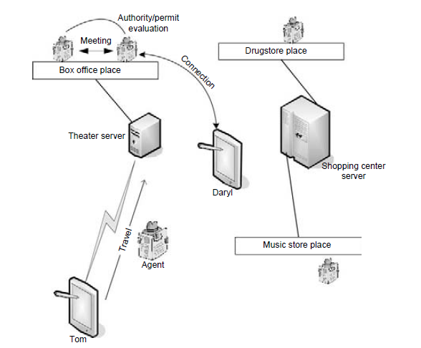
Telescript

Slide 3
Places-
In a mobile agent system, a network is composed of a set of places—each place is a location in the network where agents may visit.
Each place is hosted by a server (or perhaps a user’s personal computer) and provides appropriate infrastructure to support a mobile agent migrating to and from that location.
Places offer agents a resting spot in which they can access resources local to that place through a stationary agent that “lives” there, interacting with
other agents currently visiting that place.

Slide 4
Travel- Travel allows agents to move closer to or to colocate with needed resources.
For example, an agent dispatched by a user to obtain tickets to a jazz concert and reservations at one of several restaurants (depending on availabe by the jazz club’s box office before traveling to the places hosted by the restaurants availability) might travel from its home place to the place hosted

Slide 5
Meetings. Meetings are local interactions between two or more agents in the same place.
In Telescript, this means that the agents can invoke each other’s procedures.
The agent in search of jazz tickets and a restaurant reservation (discussed under “Travel” above) would engage in meetings with appropriate agents at the ticket office and at the restaurant’s reservation office to perform its duty.

Slide 6
Connections. Connections allow agents at different places to communicate and allow agents to communicate with human users or other applications over a network.
An agent in search of jazz tickets, for example, might contact the human who dispatched it to indicate that an additional show has been added, although the desired show was sold out (e.g., “Is the 11 P.M. show OK?”).
Connections in Telescript require an agent to identify the name and location of the remote agent, along with some other information, such as required quality of service.

Slide 7
Authorities. An agent’s or place’s authority is the person or organization
(in the real world) that it represents.
In Telescript, agents may not withhold their authority; that is, anonymous operation is not allowed—the primary justification for this limitation is to deter malicious agent activity.
When an agent wishes to migrate to another location, the destination can check the authority to determine if migration will be permitted.
Similarly, an agent may examine the authority of a potential destination to determine if it wishes to migrate there.

Slide 8
Permits- Permits determine what agents and places can do—they are
sets of capabilities.
In general, these capabilities may have virtually any form, but in Telescript they come in two flavors.
The first type of capability determines whether an agent or place may execute certain types of instructions, such as instructions that create new agents.
The second type of capability places resource limits on agents, such as a maximum number of bytes of network traffic that may be generated or a maximum lifetime in seconds.
If an agent attempts to exceed the limitations imposed by its permits, it is destroyed.

Slide 9
Migration strategies
To support the migration of agents, it must be possible to either capture the state of an agent or to spawn an additional process that captures the state of the agent.
This process state must then be transmitted to the remote machine to which the agent will migrate.
This is equivalent to process checkpointing, where the state of a process, including the stack, heap, program code, static variables, etc., is captured and stored for a later resuscitation of the process.

Slide 10
Checkpointing processes executing inside a virtual machine, such as Java processes, are a bit easier,
but currently most of these solutions also impose limitations, such as restrictions on the use of callbacks, network connections, and file activity
One solution is to impose strong restrictions on the programming model used for mobile agents.
Essentially, this entails capturing only the essential internal state of an agent, i.e., sufficient information about its current execution state to continue the computation on reconstitution, combined with a local cleanup policy.
This means that an agent might perform a local cleanup, including tearing down communication connections and closing local files, before requesting that the agent middleware perform a migration operation.

Slide 11
For example, in Aglets (Lange and Oshima, 1998), which is a Java-based mobile agents system, agents are notified at the beginning of a migration operation.
It is the responsibility of an individual agent, on receiving such a notification, to save any significant state in local variables so that the agent can be properly “reconstituted” at the new location.
Agent migration in Aglets begins with an agent initiating a migration (its own or that of another agent) by invoking dispatch().
A callback, onDispatch(), will be triggered subsequently, notifying the agent that it must save its state.
After the migration, the agent’s onArrival() callback will be invoked so that the agent can complete its state restoration.

Slide 12
Communication strategies
Communication among agents in a mobile agent system can take many forms, including the use of traditional CS techniques, remote procedure call, remote method invocation, meeting places, and coordination languages.
Each of these communication strategies has advantages and disadvantages,
some of which are exacerbated in mobile agent systems. One consideration is the degree of temporal and spatial locality exhibited by a communication scheme

Slide 13
Temporal locality means that communication among two or more agents must take place at the same physical time, like a traditional telephone conversation.
Interagent communication mechanisms exhibiting temporal locality are limiting in a mobile agent’s architecture because all agents participating in a communication must have network connectivity at the time the communication occurs.
Spatial locality means that the participants must be able to name each
other for communication to be possible—in other words, unique names
must be associated with agents, and their names must be sufficient for
determining their current location.

Slide 14
Traditional CS model
Meeting places

